Slide 1
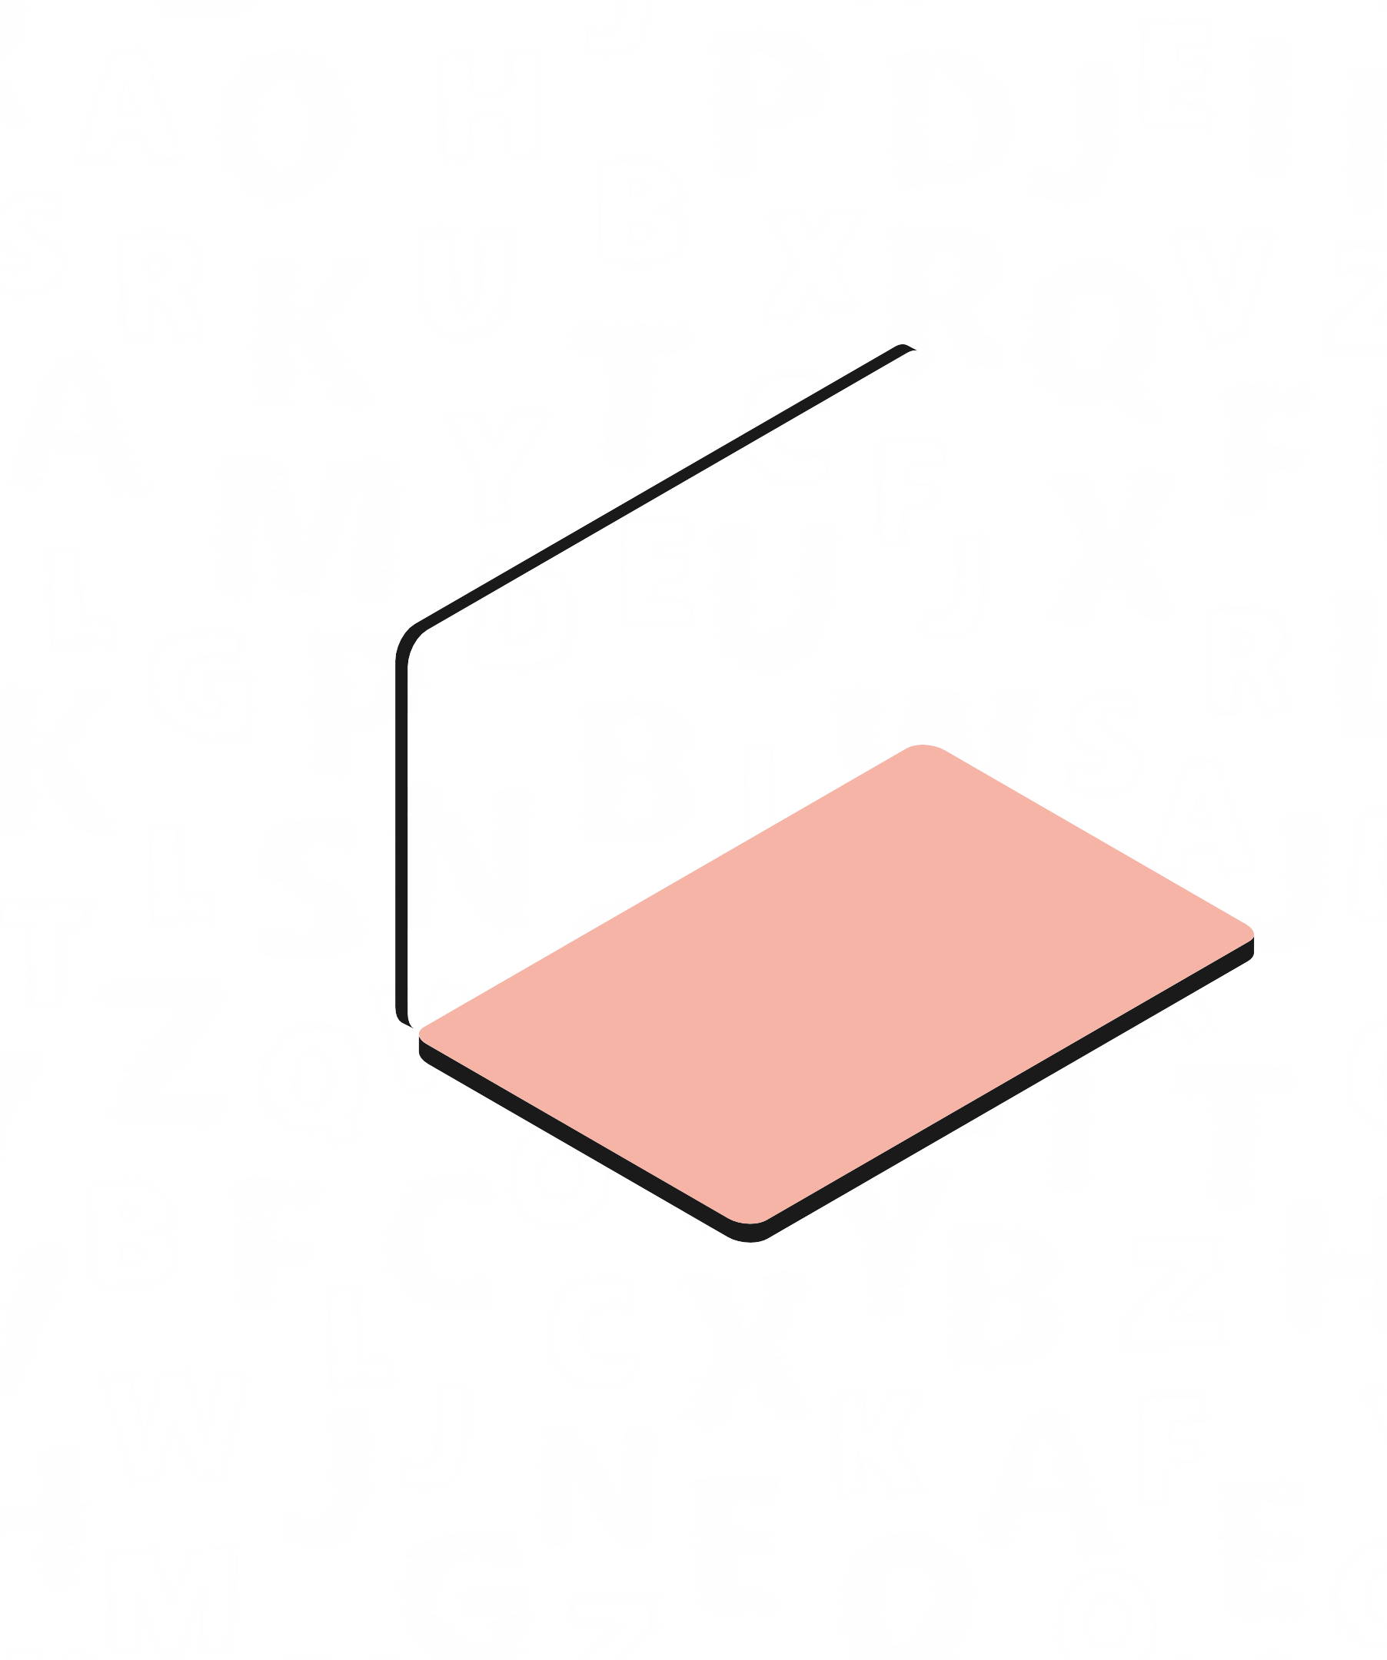


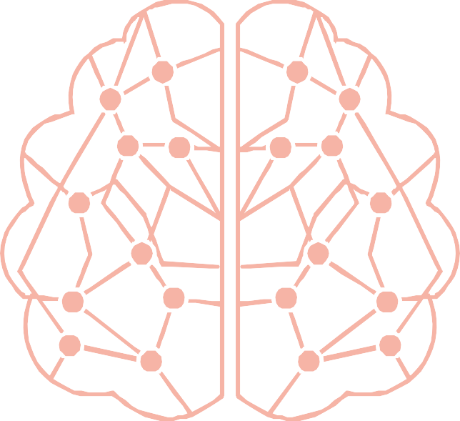
Optical Character and Digit Recognition
Using Backpropagation Algorithm

Slide 2

Agenda
KEY TOPICS DISCUSSED IN THIS PRESENTATION
Abstract.......................Introduction of OCR Goals of Implementation Objectives What is Backpropagation? Dataset Used System Design Performance Analysis Future Work References

Slide 3
Abstract
Optical character recognition (OCR) accuracy for handwritten characters can be improved by using backpropagation neural networks. These networks are trained to recognize handwritten characters by adjusting their weights based on the error between predicted and actual outputs. This approach allows the network to learn and adapt to individual writing styles, significantly enhancing OCR accuracy. The neural network is particularly effective when two hidden layers are used, which results in a lower final mean square error and higher recognition accuracy.

Slide 4

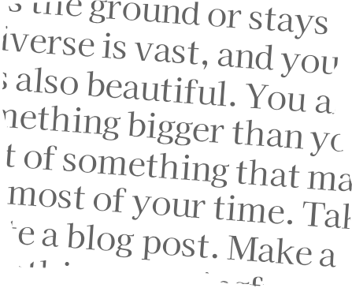
What is OCR ?
OCR stands for Optical Character Recognition, which is a technology used to recognize and extract text from images, scanned documents, and other visual media.
OCR technology has become increasingly important in today's digital world, as it allows for the digitization of printed materials, making them easier to search, edit, and share.

Slide 5
Speech Recognition
Handwriting recognition
Applications of OCR
OCR: Because who has time to type out an entire document when you can just make your computer do it for you? #LazyLife
Manufacturing
Medical record digitization
Security and law enforcement
Document processing and automation

Slide 6
Objectives
Goals of Implementation
TO DEVELOP AN OCR MODEL THAT IS ACCURATE, EFFICIENT, AND SCALABLE
To evaluate and select the most appropriate OCR model for our needs. To train our OCR model on a large and diverse dataset of character images.
To test the accuracy of our OCR model. To document our findings and share our results with the broader community.

Slide 7
What is backpropagation ?
Backpropagation is a supervised learning algorithm for training artificial neural networks. It uses gradient descent to adjust the weights and biases of the network in order to minimize the error between the predicted output and the actual output.
Forward Propagation: The input is passed through the network, and the output is calculated.
Backward Propagation: The error is then propagated back through the network, and the weights and biases are adjusted using the gradient of the error with respect to the weights and biases.
Activation Function: The activation function is used to introduce non-linearity into the network. The most common activation function used in backpropagation is the sigmoid function.
Chain Rule: The chain rule from calculus is used to calculate the gradient of the error with respect to the weights and biases. This allows the algorithm to adjust the weights and biases in the correct direction to minimize the error.

Slide 8
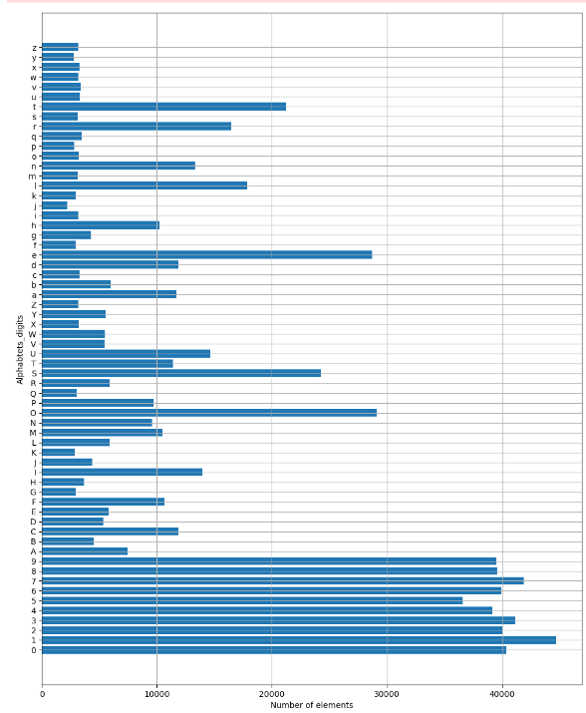
Dataset Used For Character
Consists of 28x28 pixel images of handwritten alphabets.
The images are in a pixel format.
1st column representing the labelling of the alphabet from 0-25 as A-Z.
For the Character recognition the training set is 400,000 data and the testing set consists of 1,60,000 data.

Slide 9
Dataset Used For Digits
The dataset used in this research is “emnist-digits”.
This dataset is obtained from the National Institute of Standards and Technology (NIST) and converted to a 28x28 pixel image in feature format [20].
This dataset contains handwritten digit characters from 0 to 9, with a total of 280,000. The dataset is distributed into three sets: training set, testing set, and validation set with a ratio of 5:1:1.
Thus, the training set consists of 200,000 data, while testing and validation sets consist of 40,000 data.

Slide 10
System Design
1
2
3
STEP
Data Preprocessing
- Scaling the pixel values
STEP
Model architecture - Convolutional Neural Network (CNN).
STEP
Model's performance - Accuracy

Slide 11
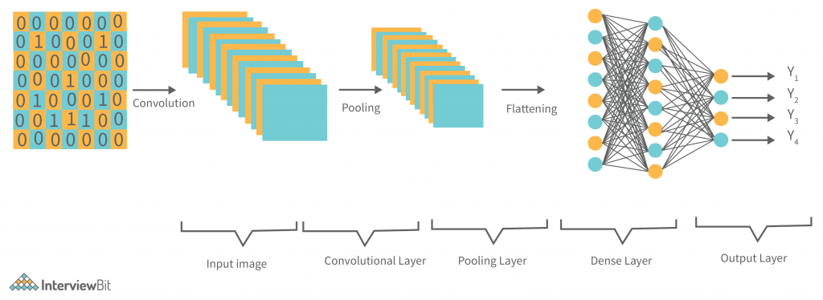
Model Architecture

Slide 12
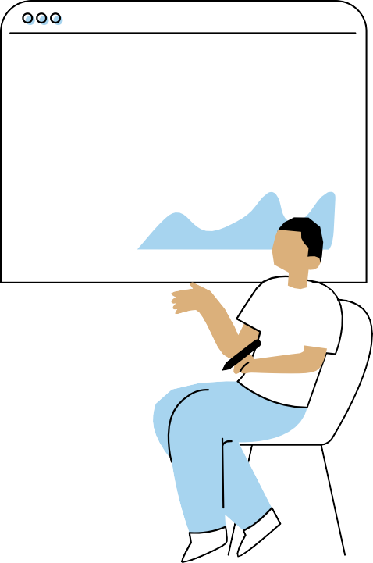

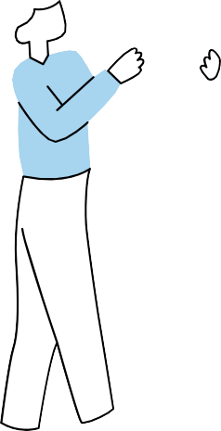

Our CNN model’s overall accuracy on the test set is 90.16%.
Accuracy on the training set - 93.12%.
For Characters

Slide 13
Our CNN model’s overall accuracy on the test set is 93.20%.
Accuracy on the training set - 95.10%.
For Digits

Slide 14

Future work
Investigating the impact of hyperparameters tuning can help to further optimize the model performance.
Extending the model to recognize characters in other languages for creating a universal OCR model.
Features like image cleaning, skew correction, and noise reduction can improve the accuracy of OCR
OCR may soon become advanced enough to recognize the doctor's handwriting. A true miracle in the making!

Slide 15

What we Learnt ?
Use of Convolutional Neural Networks (CNNs) in image recognition tasks. Significance of hyperparameter tuning for optimizing model performance. The practical applications of OCR technology.
The impact of OCR technology in various fields.

Slide 16
T. Jamtsho, K. Powdyel, R. K. Powrel, R. Bhujel and K. Muramatsu, "OCR and Speech Recognition System Using Machine Learning," 2021 Innovations in Power and Advanced Computing Technologies (i-PACT), Kuala Lumpur, Malaysia, 2021, pp. 1-5, doi: 10.1109/i- PACT52855.2021.9697030.
References
I didn't come up with this all by myself, you know? Here are the sources that made me look smart:
https://www.kaggle.com/datasets/sachinpatel21/az-handwritten- alphabets-in-csv-format
https://www.tensorflow.org/api_docs/python/tf/keras
https://docs.opencv.org/4.x/
A. Pal and D. Singh, “Handwritten English Character Recognition Using Neural Network”

Slide 17
THANK YOU

